Slide 1

Game Design Goal Oriented Approach for Procedural Content Generation
National Taiwan University of Science and Technology
Department of Computer Science and Information Engineering
Ze-Hao Wang
Master Thesis Oral Defense
July 27, 2017
Prof. Wen-Kai Tai
Committee Chairperson
Prof. Hsing-Kuo Pao
Committee Member
Prof. Tung-Ju Hsieh
Committee Member
Prof. Wen-Huang Cheng
Committee Member

Slide 2
Agenda
Introduction
Related Works
Mission / Space framework
Map Sketches & Evolution of Segments
Proposed Methodologies
System Framework
Mission Grammars
Build Volumes
Generate Space
Volume Evolution
Experimental Results
Conclusions and Contributions
Future work

Slide 3
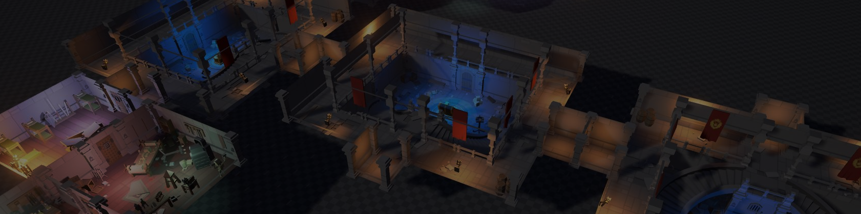
Introduction
Motivation
Research Goals

Slide 4

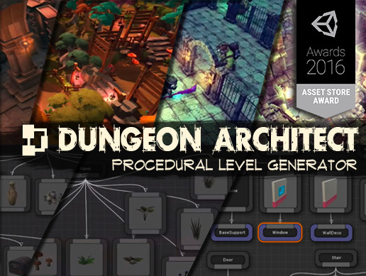

Motivation
程序化內容自動生成 (Procedural Content Generation) 在過去就廣泛被應用於遊戲設計領域，其主要目的為增加遊戲內容的隨機性與多樣性。
我們預期讓玩家在進行遊戲時能夠遵循關卡設計師的劇情脈絡外，亦能夠體驗到有意義且多樣化的遊戲關卡內容。
 | Dungeon Architect | DunGen
Build spatial topology | Randomly PCG, Manually | Randomly PCG
Mission-based topology | None | Stable-linear structure
Dungeon Architect
DunGen

Slide 5
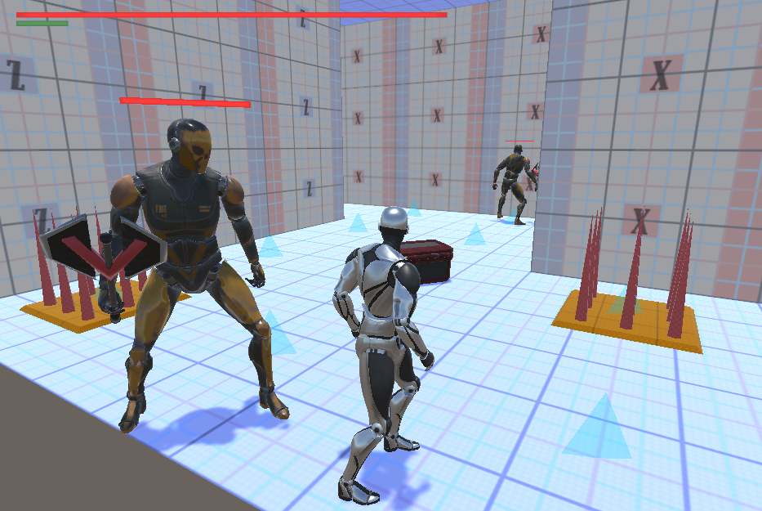
Research Goals
我們針對遊戲過程中的遊玩特徵 (gameplay patterns) 進行抽象化。
使用程序化生成技術產生帶有意義遊戲關卡內容，藉此消彌或降低因隨機性所產生的不穩定要素，以改善並豐富遊戲體驗。
 | Our Method | Dungeon Architect | DunGen
Build spatial topology | PCG | Randomly PCG, Manually | Randomly PCG
Mission-based topology | Dynamic-nonlinear, meaningful structure | None | Stable-linear structure
Game Patterns | Genetic Algorithm | None | None
Our Method

Slide 6
Research Goals (Cont’d)
Referenced Level Generation Methods
Joris Dormans – Mission/Space framework
Antonios Liapis – Sentient Sketchbook
Method / Framework | Mission progress | Evaluate content
Mission / Space framework | Accurately control | None
Sentient Sketchbook | None | Provide via GA

Slide 7
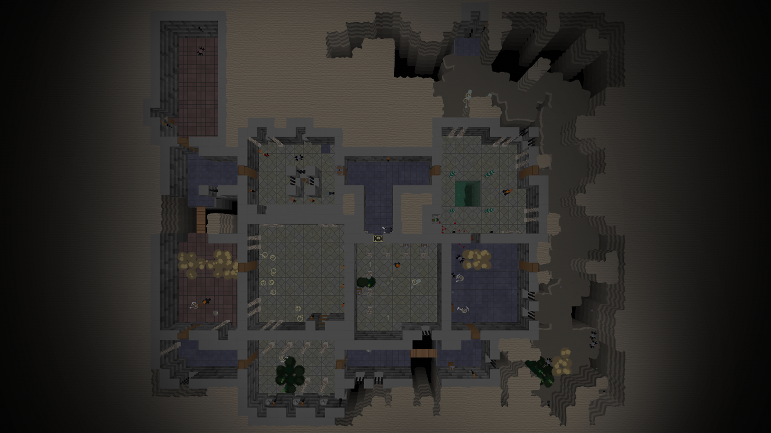
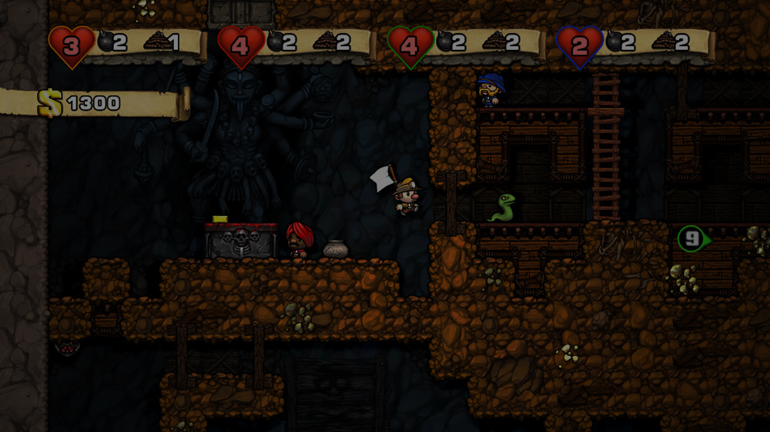
Related Works
Mission / Space framework
Map Sketches & Evolution of Segments

Slide 8
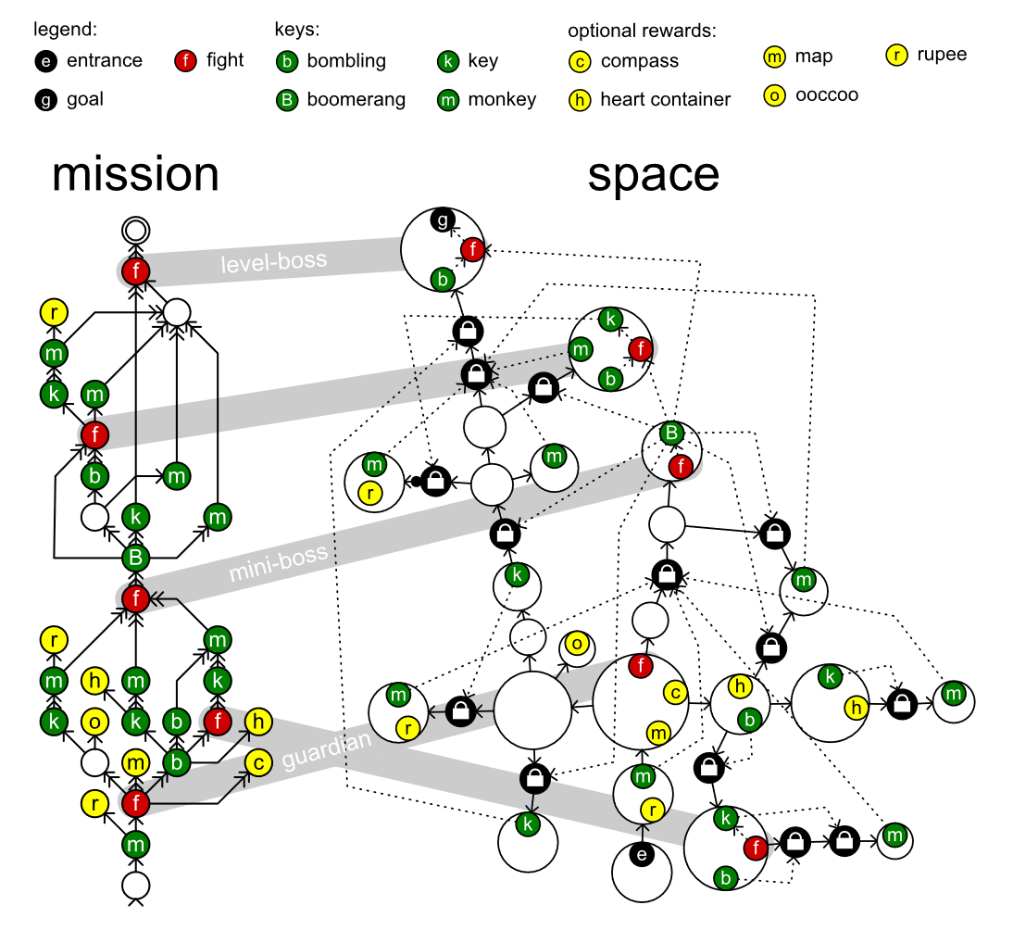
Mission / Space framework
Mission/Space framework, focuses on level design and the mechanics that control player progression through a game.
Transformational Grammars
Mission Grammars
Mission Graph Convert into Space Graph

Slide 9
Transformational Grammars
Be consisted from an alphabet and a set of rules
Alphabet It is a set of symbols the grammar works with.
Set of rules It specifies what symbol can be replaced by what other symbols to form a new string.
Sides and symbols of the rule
Terminals (common in lowercase) Symbols in the alphabet can never be replaced because there are no rules.
Non-terminals (common in uppercase) Symbols have rules that specify their replacement.
S → ab
Symbol
Symbol
Symbol
{ S, a, b } is an alphabet

Slide 10

Mission Grammars
Inhibitions
Available when at least one of the weak prerequisites is completed.
Strong requirement
Available when all strong prerequisites are completed.
Weak requirement
Available when at least one of the weak prerequisites is completed.
Example of mission graph
Mission graphs represent the players’ progress towards a goal not by tracking their physical location, but by tracking the tasks they must perform to finish a level.
A mission graph is a directed graph that represents a sort of to-do list with each node representing a task that might or must be executed by the players.

Slide 11
Mission Graph Convert into Space Graph
The steps in the generation progress investigated in this paper in detail:
An alternative method, does not go into detail:
Mission
Map
Space
Refine
Level
Create
Space
Distill
Mission
Adjust
Space
Refine
Level
Create

Slide 12
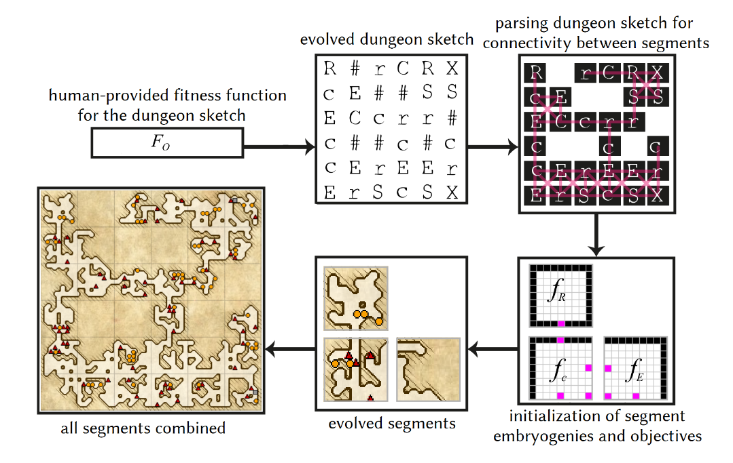
Map Sketches & Evolution of Segments
Map Sketches
Map Sketch Evolution
Dungeon Segments
Dungeon Segment Evolution

Slide 13
Proposed Methodologies
1. System Framework
2. Mission Grammars
3. Build Volumes
4. Generate Space
5. Volume Evolution

Slide 14
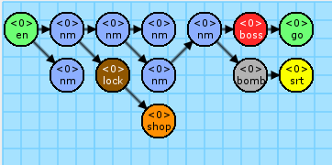
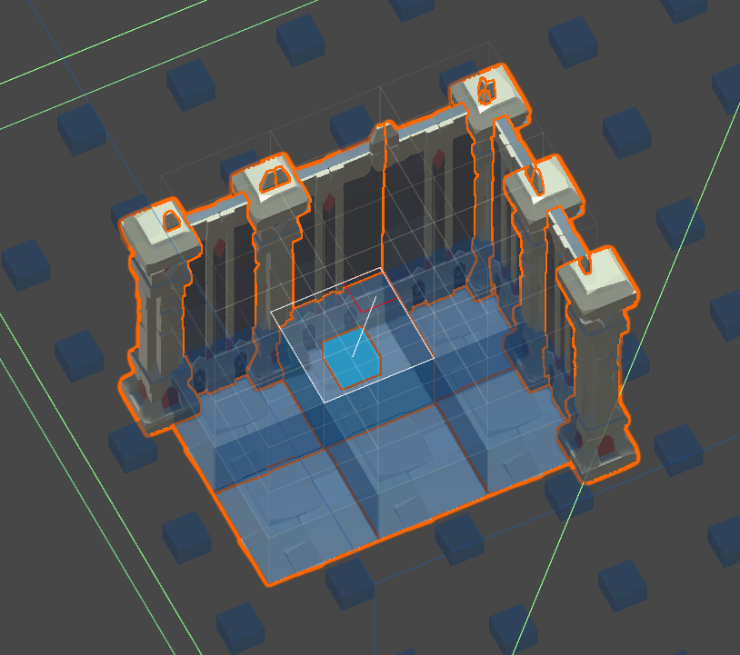
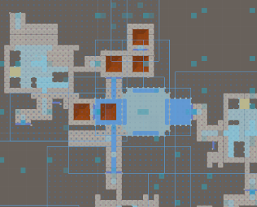
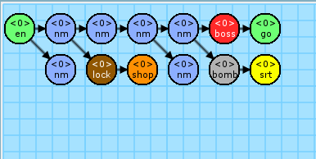
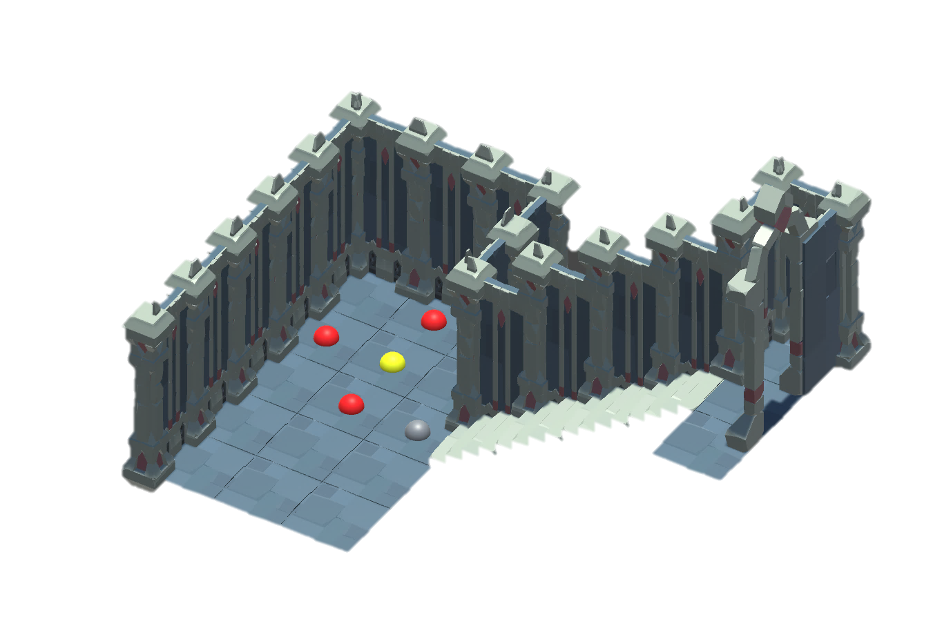
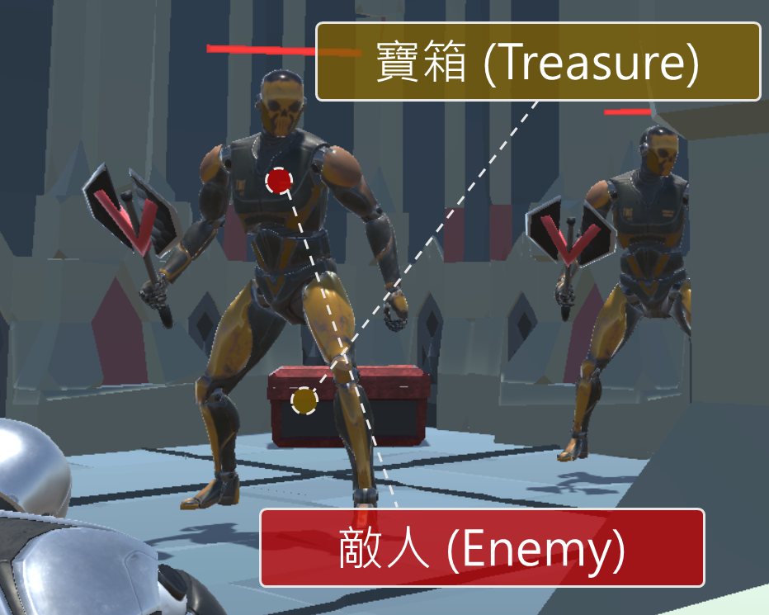
System Framework
Mission grammars
Build volumes
Generate Space
Volume Evolution
Completed level

Slide 15





System Framework
1. Mission Grammars
Mission Alphabet
Extract game patterns
Mission Rules
Linear and non-linear rules
Mission Graph
Rewrite System I
Left
Right
1
2
3

Slide 16
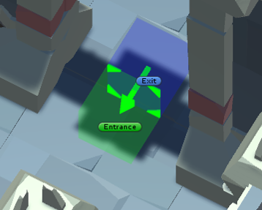
System Framework
2. Build Volumes
Volume
Voxel-based and decorations
Connection
Entrance and Exit markers
4
5

Slide 17
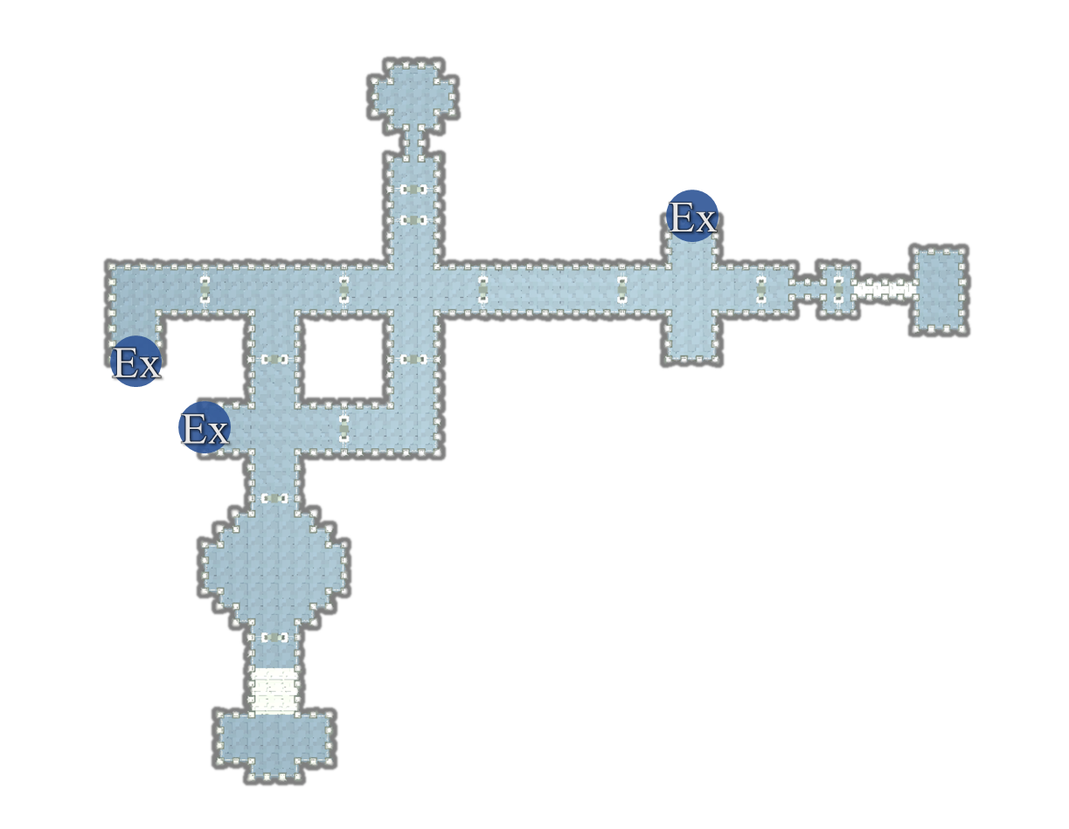
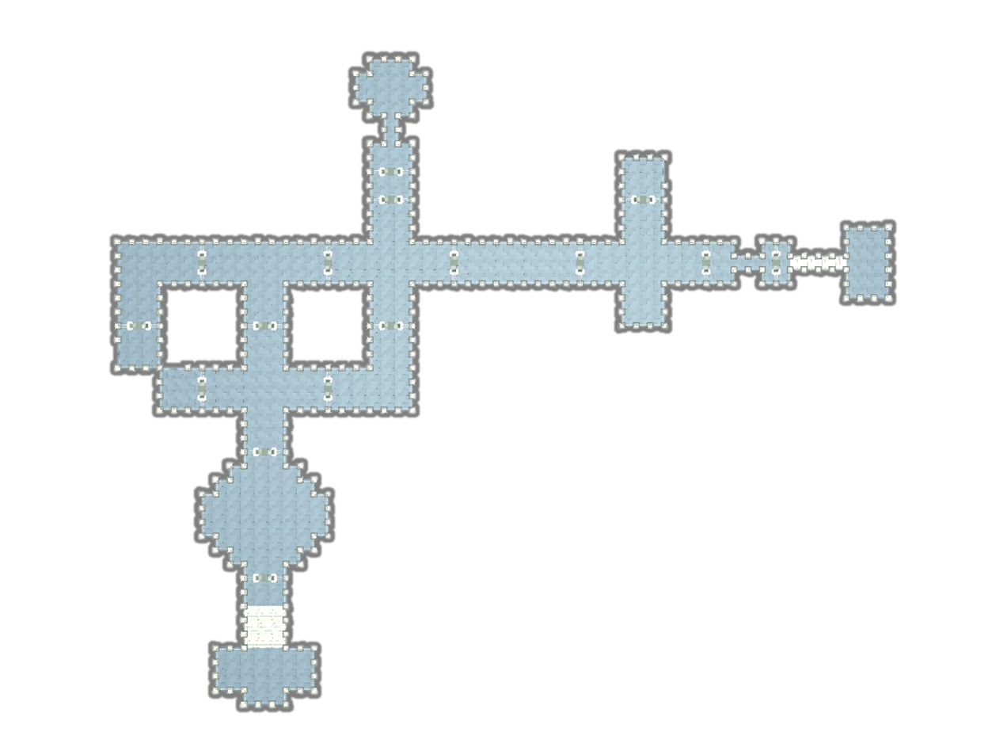
System Framework
3. Generate Space
Mission to Space
Rewrite System II (Instruction)
Mission to Space
Rewrite System II (Replacement)
Nodes
Volumes
Connections
Volumes
>
>
6
7

Slide 18
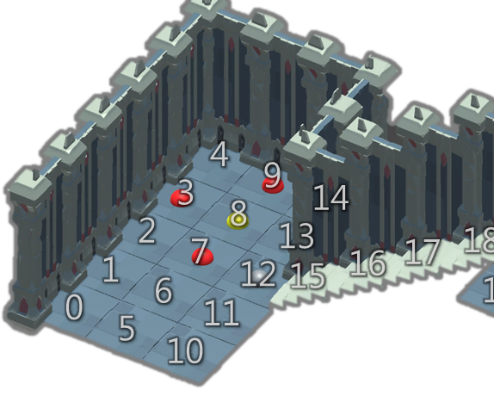
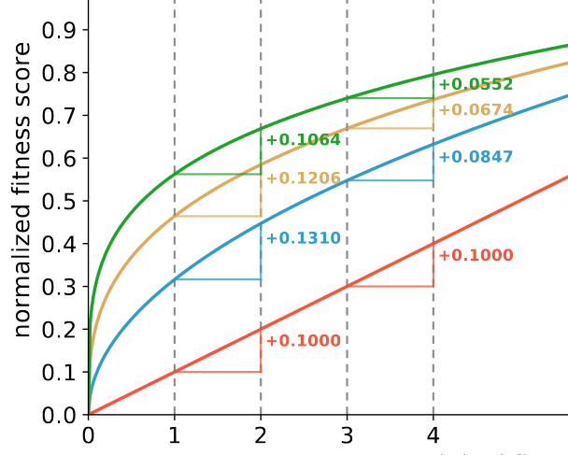
System Framework
4. Volume Evolution (Generate the Gameplay Patterns)
Genes
Passable tiles
Fitness functions
Design the metrics
Normalization
Control the amplitude
Evolution
Adjust weights of fitness functions
8
9
10
11

Slide 19
System DEMO
Video here

Slide 20
Section 1. Mission Grammars
Export the mission graph

Slide 21
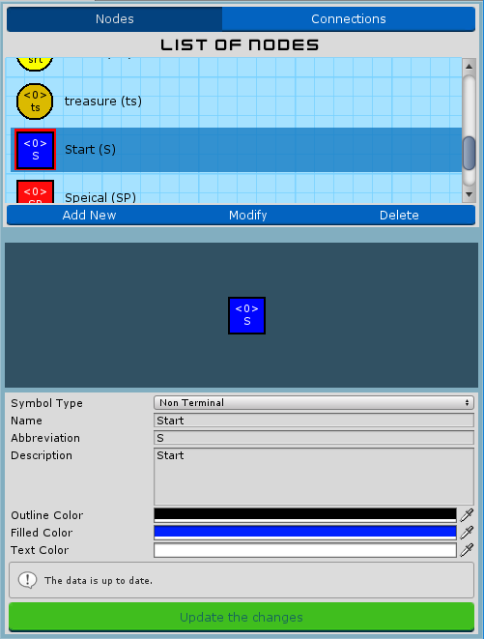
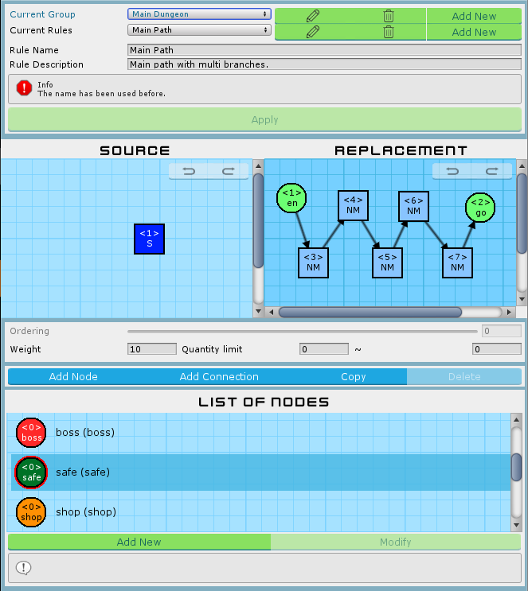
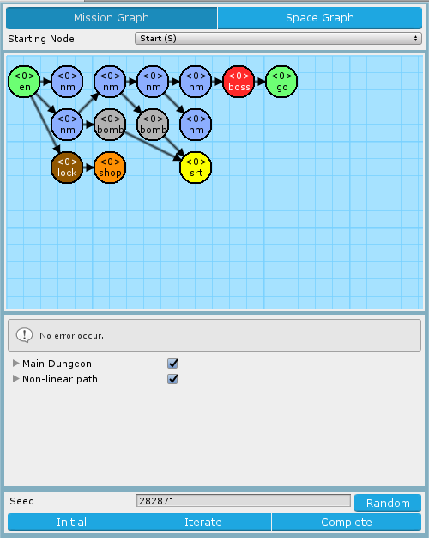


Mission Grammars
Mission Alphabet
Mission Rules
Mission Graph

Slide 22
Introduction of Mission Alphabet
List of symbols
Nodes and connections
Directly preview before selected
Preview area
Preview the symbol after editing immediately
Submit hint and form validations
Default and extended nodes
Default: Entrance, Goal
Extended: Any
Mission Alphabet Window

Slide 23
Introduction of Mission Rules
Hierarchy structure
Groups > Rules > Graph Grammar of Left-hand side & Right-hand side Rules
Friendly interface to create, delete and edit.
Rule canvas
Drag & drop to modify symbols
Custom size of canvas
Selected symbol highlighting
Connections stick on nodes automatically
Back trace the states (Redo / Undo)
Mission Rules Window

Slide 24
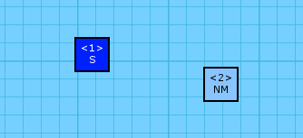
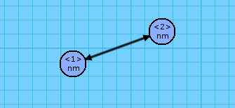
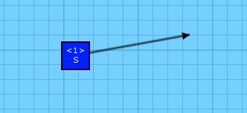
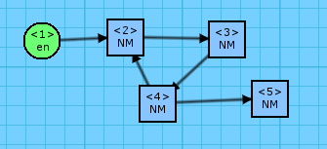
Avoid the illegal mission rules
Illegal rules will lead to the rewrite system generating fail or encounter the loop.
Isolated Node
Multiple Relations
And else ...
Isolated Connection
Cyclic Link

Slide 25
Set of illegal mission rules
Illegal pattern | Description
Left More Than Right | 當左側的節點超過右側的節點數量時，進行改寫系統會使左側無法對應到右側的節點產生遺失的情形。若這些節點原先已有與其它非規則內節點連接，將會導致該連接資訊遺失，有機會造成任務圖破碎。
Empty Left | 左側為空將無法進行子圖搜索，因此左側節點必須至少一個節點。
Isolated Node | 孤立的節點將會導致任務圖破碎。
Isolated Connection | 孤立的連接線無法正確表示其連接資訊，將無法正常進行改寫系統。
Exactly Duplicated | 若左右規則同構將導致改寫系統陷入無限循環。
Multiple Relations | 兩兩節點間不可有超過一個的連接關係，不論是同向連接線或反向連接線皆會導致改寫系統無法正常運作。
Cyclic Link | 任務圖的定義中，任務應嚴格遵守任務間之順序性，若有循環結構將會使玩家迂迴停滯。
Orphan Node | 若有圖形語法含有兩個以上的根結點，便無法正確定位出任務起點。
Overflowed Any Node | 當右側規則使用 Any 節點時，其對應到左側索引值的節點亦必須為 Any 節點。反之，左側規則使用 Any 節點將不在此限。

Slide 26
Introduction of Mission Graph
Set starting node
The head of the mission graph
Preview mission graph
Rewrite system I
Based on the selected rules in mission grammars
Find the matched subgraphs using rules
VF Graph Isomorphism Algorithm ^{[1]}
^{[1]} VF Graph Isomorphism Algorithm: | https://www.codeproject.com/Articles/23144/A-C-Implementation-of-the-VF-Graph-Isomorphism-Alg
Mission Graph Window

Slide 27
Rewrite System I
Find the matched rule from all rules
Randomly pick one if found many rules.
Current mission graph and left-hand side of rule are subgraph isomorphic.
Update the mission graph from the matched rule
Iterating until all nodes are replaced to terminal nodes.

Slide 28
“FindMatchs” works
1:A
2:B
legal
1:A
2:D
illegal
A
B
…
c
1:A
2:c
legal
1:B
illegal
Current mission graph
Left-hand side of mission rules
1:A
2:B
…
2:B
2:B
4:B
…
1:A
1:a
3:b
Current mission graph
Matched rule

Slide 29
Pseudocode of FindMatchs
1 2 3 4 5 6 7 8 9 10 11 12 | function FindMatchs(root, rules) matchRules is an empty array of rule graph = TransformToGraph(root) for all rule ∈ rules do: // Based on mission rule table if graph is isomorphic with left of rule then: matchedRules add rule end if end for selectedRule = RouuletteWheel(matchedRules) // Selection is based on random table. SetIndexes(root, selectedRule) return selectedRule end function

Slide 30
“Rewrite System I” works
1:A
2:B
…
1:a
2:B
…
…
…
a
b
B
B
…
1. RemoveConnections
2. ReplaceNodes
…
…
…
5. RevokeIndexes (Final)
1:a
2:B
…
1:a
2:B
…
3:b
4:B
3:b
4:B
Matched rule
2:B
2:B
4:B
1:A
1:a
3:b
3. AppendNodes
4. ReAddConnections

Slide 31
Pseudocode of Rewrite System I
1 2 3 4 5 6 7 8 9 10 11 12 13 14 15 | Initialize random number generator via seed // Seed will affect the selection in FindMatchs function RewriteSystem1(root, rules) matchedRule = FindMatchs(root, rules) if matchedRule is found from root and root doesn’t be explored then: RemoveConnections(root, matchedRule) // Remove the connections of matched parts. ReplaceNodes(root, matchedRule) // Replace the nodes based on right-hand side AppendNodes(root, matchedRule) // Append the nodes that additional index in right-hand ReAddConnections(root, matchedRule) // Re-add the connections based on right-hand side RevokeIndexes(root, matchedRule) // Revoke the index information of nodes in graph end if for all child ∈ children of root do: // DFS RewriteSystem1(child, rules) end for return root end function

Slide 32
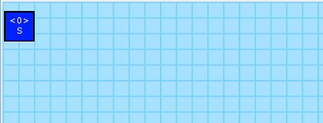
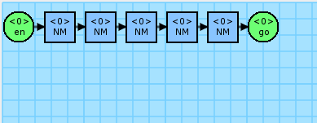
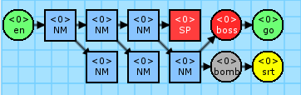
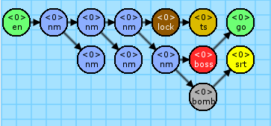
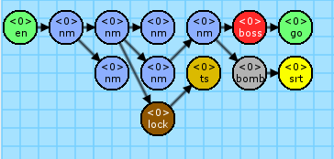
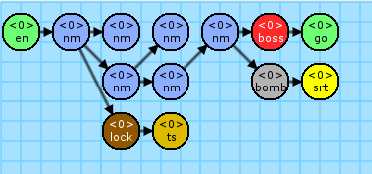
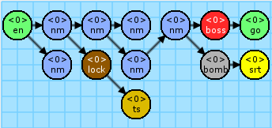
Perform iteration

Slide 33
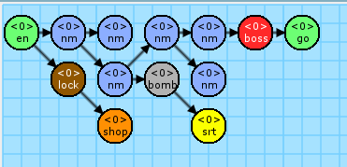
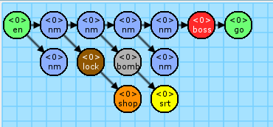
Example of Mission Graph
(a) Seed = 653543
(b) Seed = 246617
(c) Seed = 185606
(d) Seed = 183434

Slide 34
Manual
A
Create the Mission Alphabet
Node | Start | entrance | Normal | normal | boss | goal | Special | shop | bomb | lock | secret | treasure | any
 | (S) | (en*) | (NM) | (nm) | (boss) | (go*) | (SP) | (shop) | (bomb) | (lock) | (srt) | (ts) | (?*)
Display
Require-ment |  |  |  |  | Battle and end |  | Multi -choice | Get the key from secret, then enter the secret or treasure room behind the wall that need to use the bomb to destroy it
S
en
NM
nm
boss
go
SP
shop
bomb
lock
srt
ts
?
* Means the nodes are system default nodes.

Slide 35












Manual
B
Design the Mission Rules
 | Left-hand | Right-hand
Main Path |  |  | Weight: | 10
 |  |  | Limit: | [0, ∞]
Boss Room |  |  | Weight: | 150
 |  |  | Limit: | [0, 1]
Set Secret |  |  | Weight: | 30
 |  |  | Limit: | [1, 1]
Expora-tion |  |  | Weight: | 10
 |  |  | Limit: | [0, ∞]
More Branch |  |  | Weight: | 20
 |  |  | Limit: | [0, 2]
 | Left-hand | Right-hand
Shop |  |  | Weight: | 10
 |  |  | Limit: | [0, 1]
Treasure |  |  | Weight: | 10
 |  |  | Limit: | [0, 1]
Forward Lock |  |  | Weight: | 10
 |  |  | Limit: | [0, 2]
Flat Rooms |  |  | Weight: | 10
 |  |  | Limit: | [0, ∞]

Slide 36
Manual
C
Export the Mission Graph
Set the starting node
Start to execute the iteration from the root.
Set the random seed (Random number table)
Seed affects selection when there are many candidates, or and the additional iterations ^{[1]} in the moment.
^{[1]} additional iterations: | The completed generation means all nodes in the graph are replaced to terminal nodes. Additionally executes more iterations to parallel rewrite the current graph.

Slide 37
Section 2. Build Volumes
Build the volumes of level

Slide 38
Build Volumes
Editor
Voxel-based units
Markers I - Decorations
Markers II - Connections

Slide 39
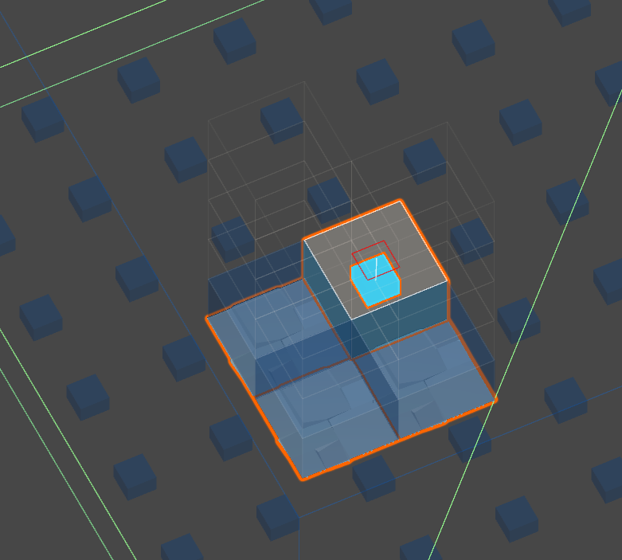
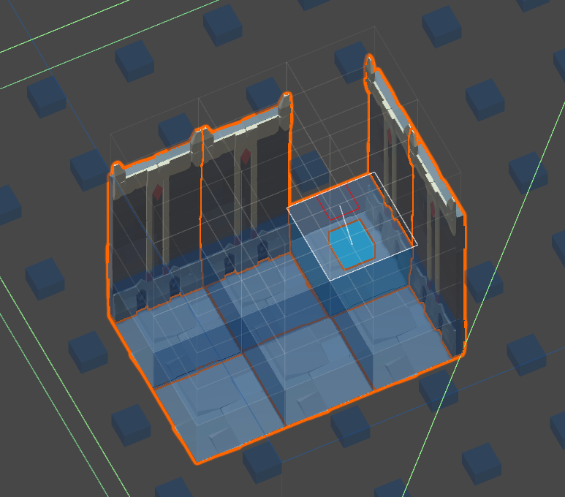
Voxel-based units in Editor
Hierarchy data structure
Level A set of volumes. Expresses a complete game level.
Volume A set of chunks. Mostly expresses a room.
Chunk Consists of 9x9x9 voxel. Based on the size of volume, uses different numbers of chunk.
Voxel The minimum unit of level, size is 3x2x3. It’s property is a decoration with nine orientations.
Floors
Walls
Pillars

Slide 40

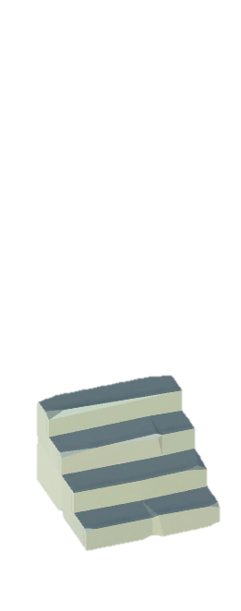
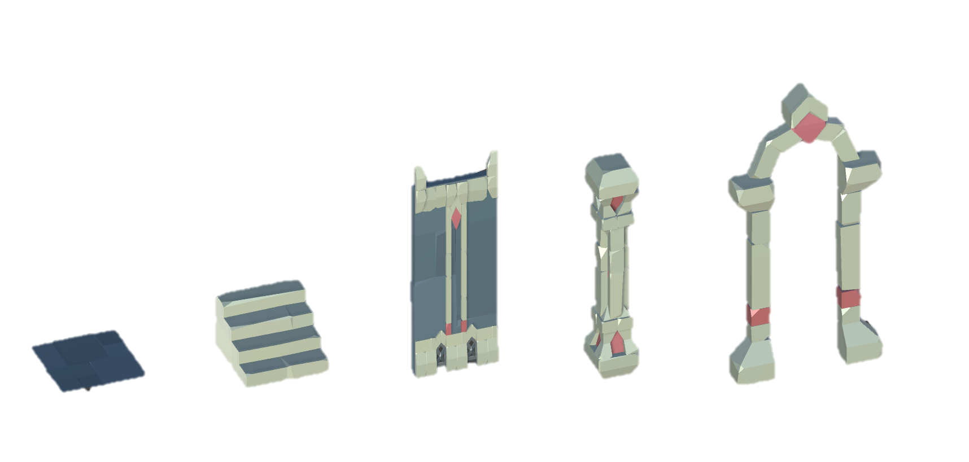

Decorations in Editor
Floor
Stair
Wall
Pillar
Door

Slide 41
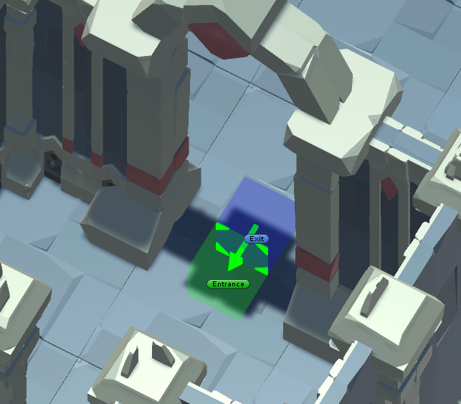
Connections in Editor
Volume A
Entrance
Zero or one
Inner direction
Exit
Any amount
Outer direction
Volume B
The exits of “volume A” will stick with the entrance of “volume B”, according to their direction of arrow. If doesn’t exist any entrance, will pick one exit randomly.

Slide 42
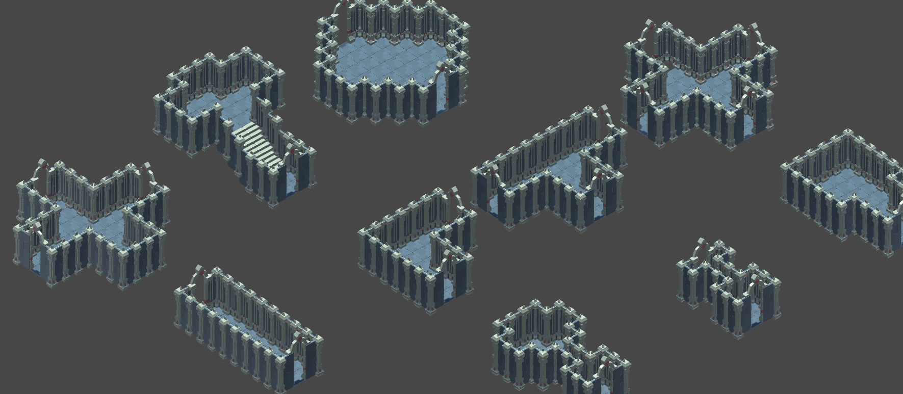
Manual
D
Design the Volumes
Must prepare the volumes to map the mission alphabet.
Must exist one entrance or exit at least each volume.

Slide 43
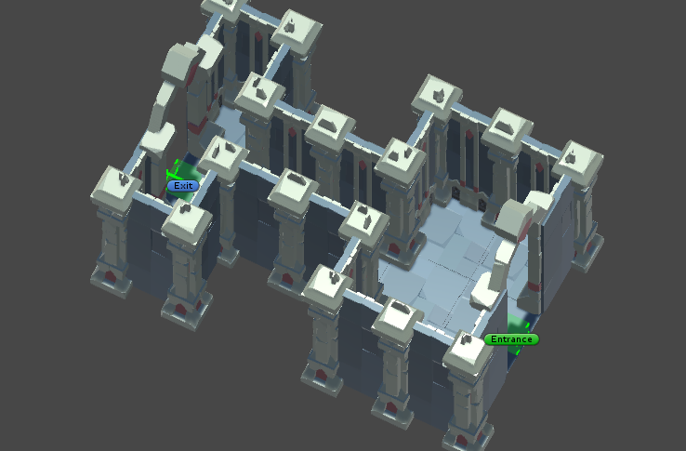
Manual
E
Append the Entrance & Exit
Append the connection marker with direction
Binding will based on their y-axis layer
Stochastic one exit will be an entrance if don't exist entrance marker in the volume

Slide 44
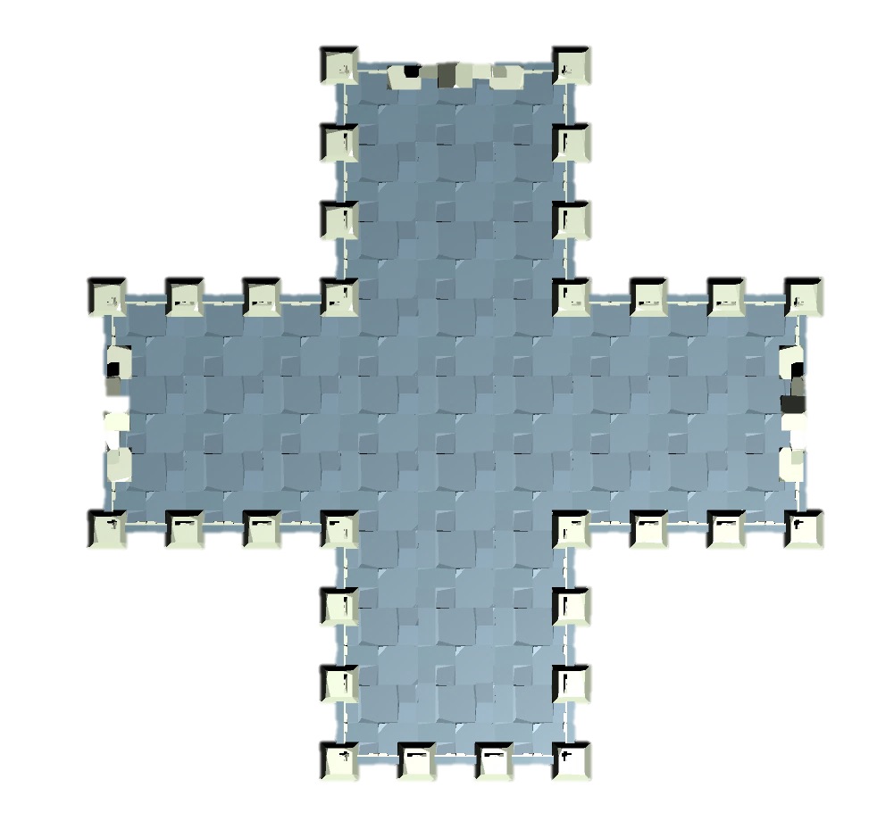
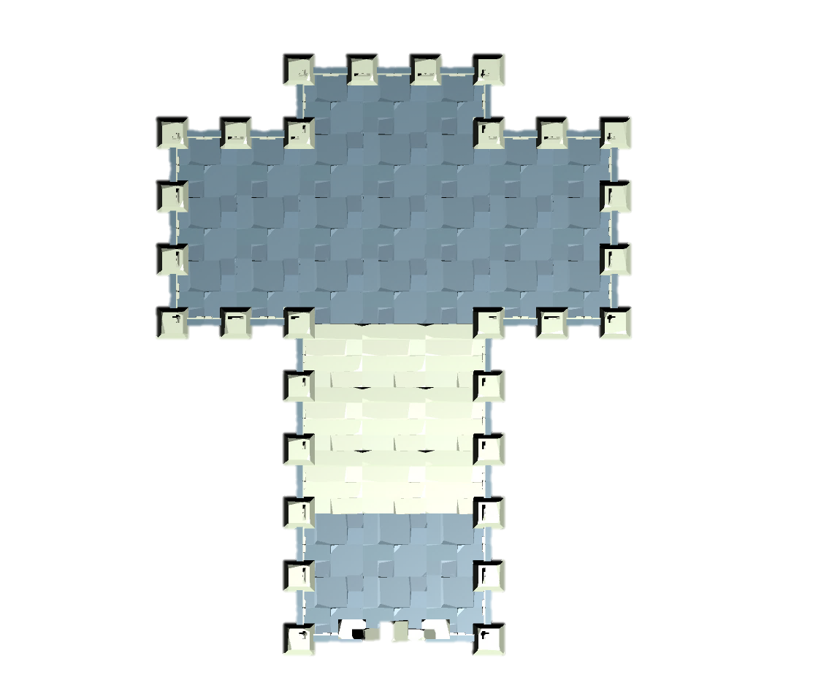
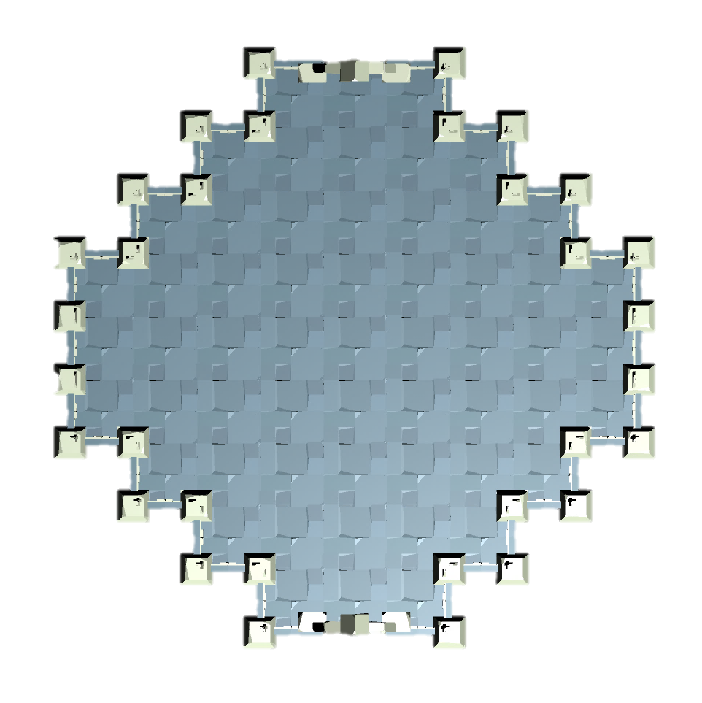
Volumes List
Ex
Ex
Ex
Ex
En
En
En
entrance
goal
boss

Slide 45
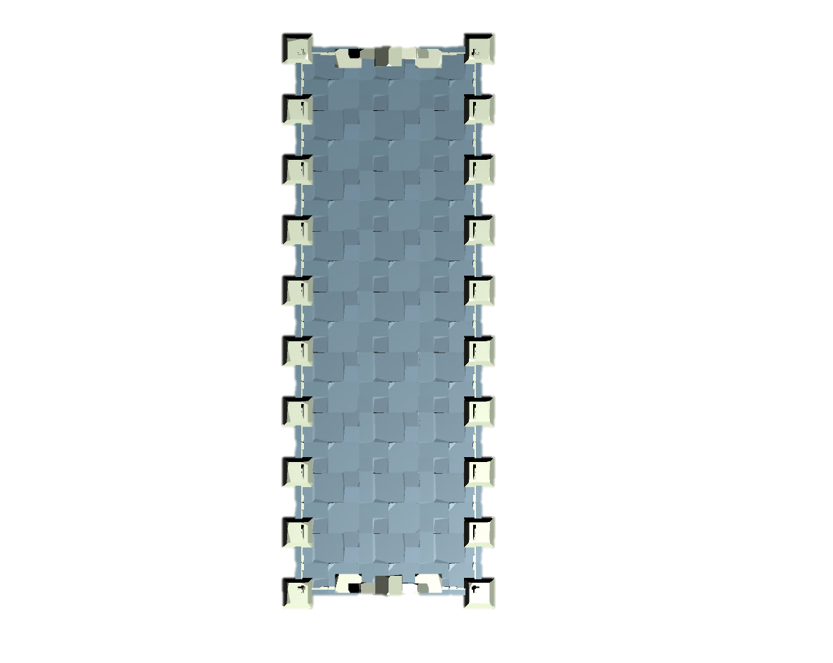
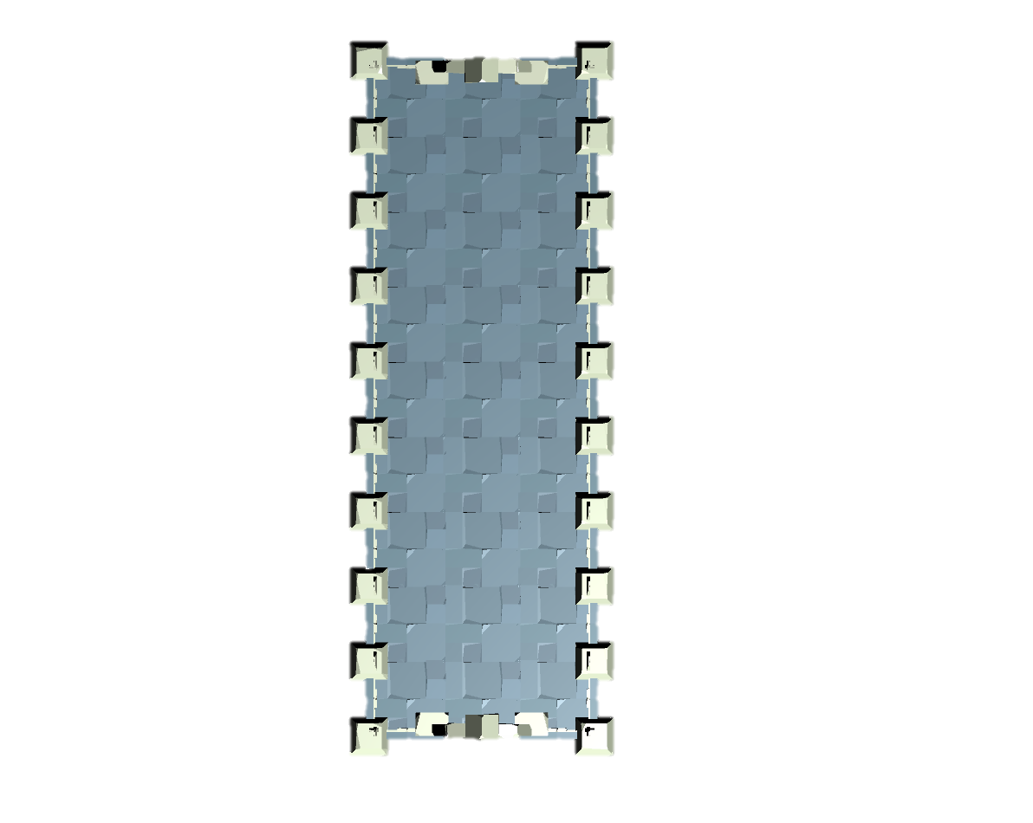
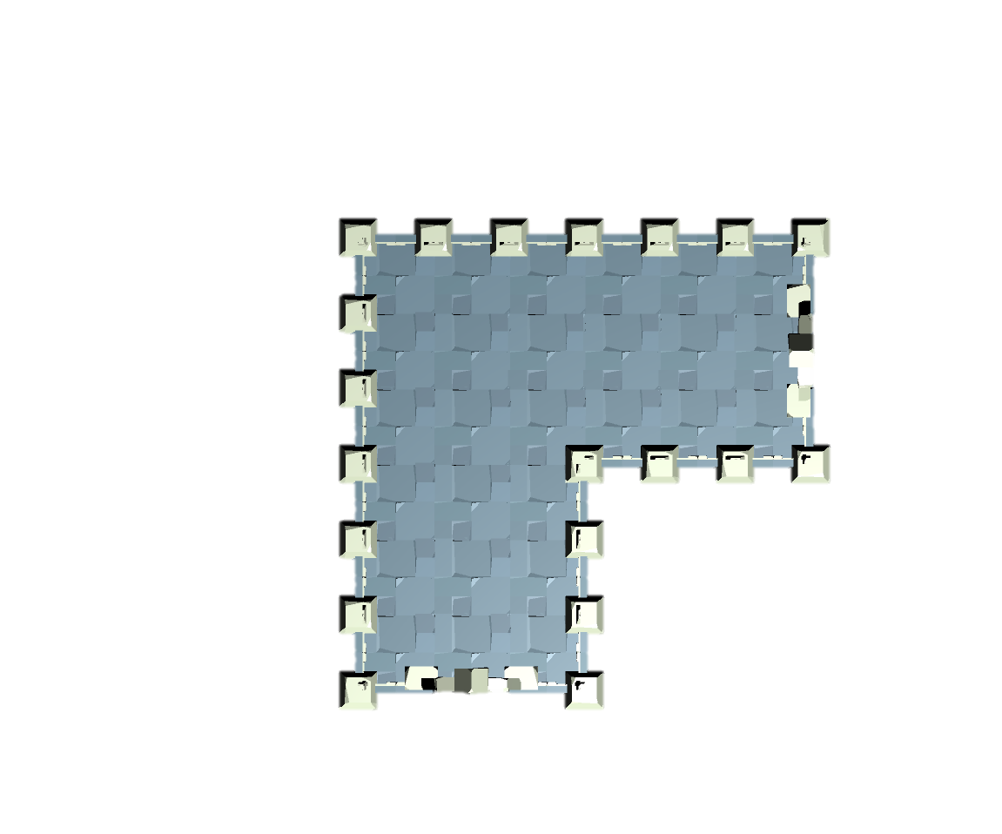

Volumes List
Ex
Ex
Ex
Ex
Ex
Ex
Ex
Ex
Ex
Ex
Ex
Ex
normal (I path)
normal (L path)

Slide 46
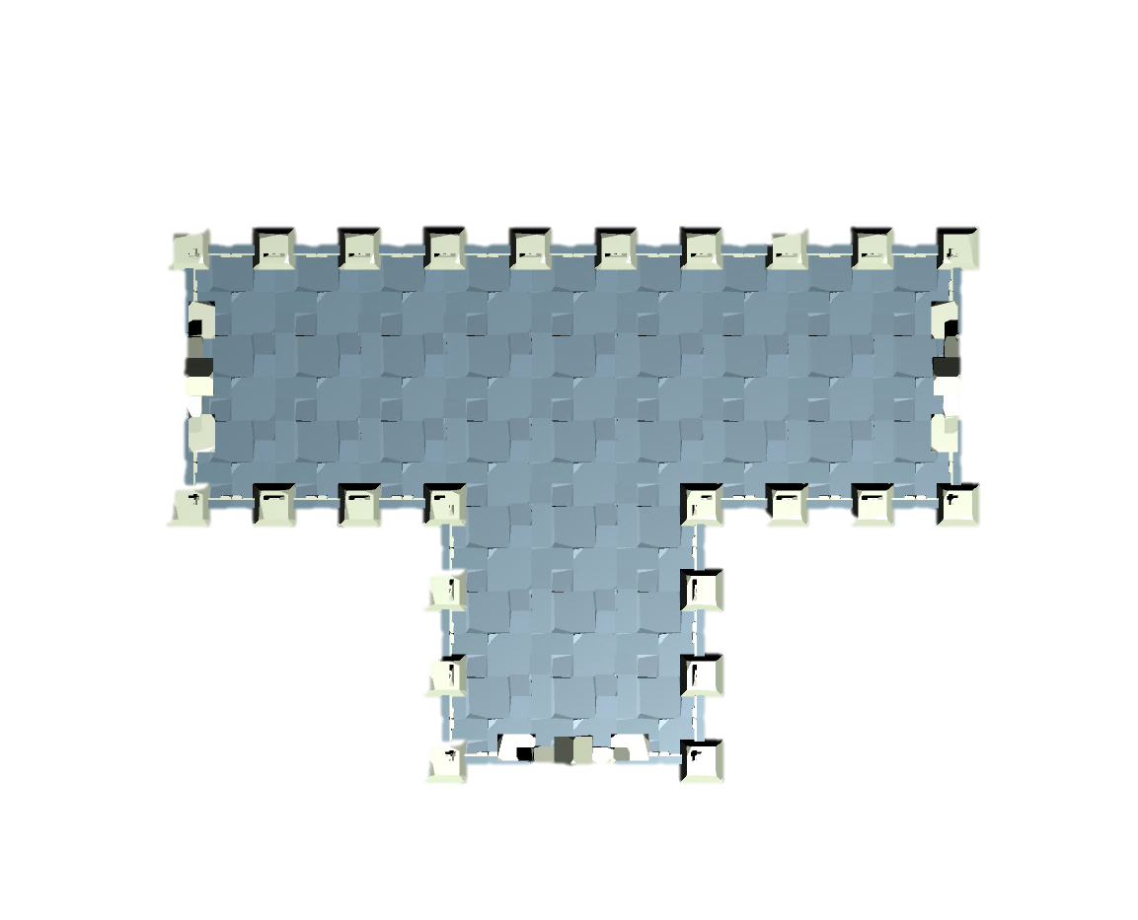
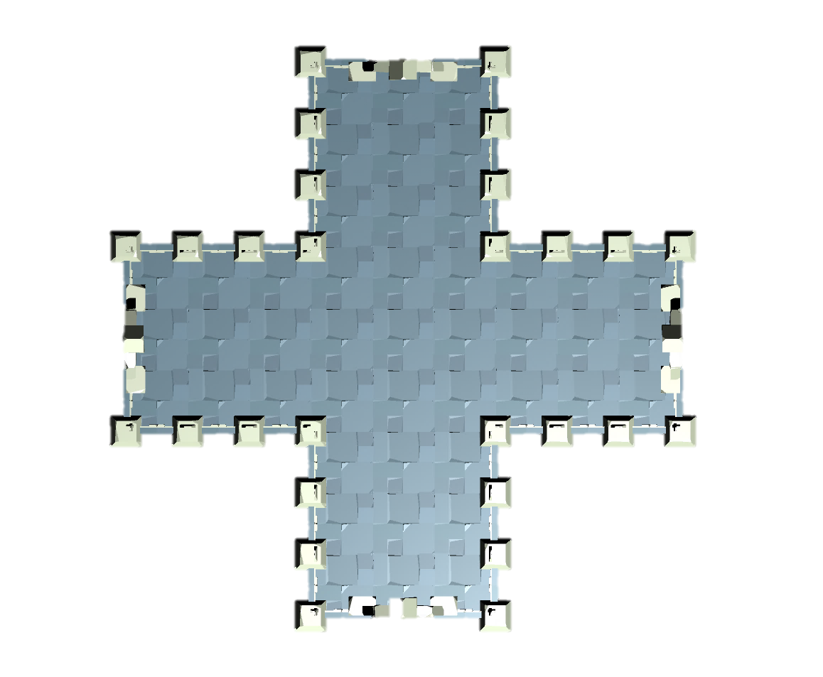
Volumes List
Ex
Ex
Ex
Ex
Ex
Ex
Ex
Ex
Ex
Ex
Ex
Ex
Ex
Ex
Ex
normal (T path)
normal (+ path)

Slide 47
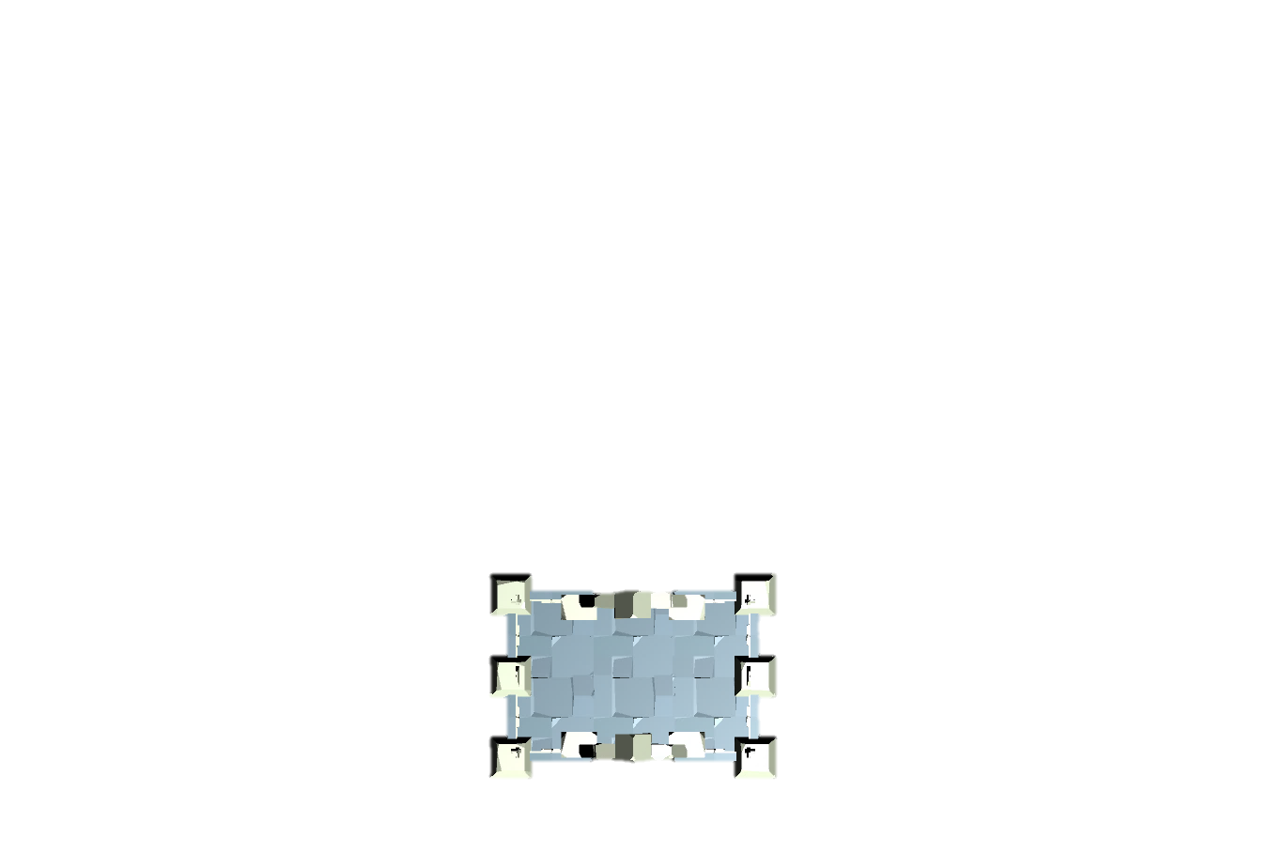


Volumes List
Wall marker
Lock marker
Ex
Ex
En
En
En
bomb (stable wall)
secret
lock

Slide 48


Volumes List
En
En
shop
treasure

Slide 49

Volumes List
En
wall

Slide 50
Section 3. Generate Space
Mission graph transforms into level space

Slide 51


Rewrite System II
Rewrite System II
Instruction
Replacement
Pseudocode
Based on the mission graph, transform it into space

Slide 52
Instruction of Rewrite System II
Instruction Table:
en
:
go
:
en
nm
go
nm
:
nm
:
Each rule in the shape grammar was associated with a terminal symbol in the mission grammar.
Look for rules that implement that symbol, selects one at random based on their relative weight.

Slide 53






“Instruction of Rewrite System II” works

Slide 54
Pseudocode of Rewrite System II
1 2 3 4 5 6 7 8 … 15 16 | Initialize random number generator via seed // Seed will affect the selection. function RewriteSystem2(graph) for all child ∈ graph do: // DFS volume = GetVolumeFromInstructionTable(node) // Selection is based on random table. isSucceed = SetVolumeToSpace(volume) // Selection is based on random table. if isSucceed is false then return false end if end for // Another part (Replacement). return true // Successfully transforms into level space. end function

Slide 55

Replacement of Rewrite System II
Replacement Table:
Ex
Ex
:
Ex
Each rule in the shape grammar was associated with a connection marker.
Look for rules that implement that symbol, selects one at random based on their relative weight.

Slide 56
Pseudocode of Rewrite System II
1 2 … 9 10 11 12 1314 15 16 | Initialize random number generator via seed // Seed will affect the selection. function RewriteSystem2(graph) // Another part (Instruction). for all marker ∈ ConnectionsInGraph do: volume = GetVolumeFromReplacementTable(marker) // Selection is based on random table. isSucceed = SetVolumeToSpace(volume) // Selection is based on random table. if isSucceed is false then return false end if end for return true // Successfully transforms into level space. end function

Slide 57

Manual
F
Defined the Instruction of Rewrite System
List of the terminal symbols from Mission Grammars.
Elements in list, they have own volume list.

Slide 58

Manual
G
Defined the Replacement of Rewrite System
List of the connection markers from Volume Manager.
Elements in list, they have own volume list.

Slide 59












Instruction Table
en
go
boss
bomb
lock
nm
nm
srt
shop
ts
nm
nm

Slide 60

Replacement Table
Ex

Slide 61
Section 4. Volume Evolution
Generate the game objects in volumes to express gameplay patterns

Slide 62
Volume Evolution
Genetic Algorithm
Algorithm flow
Gene
Crossover
Mutation
Fitness functions of GA
Common parts
Metrics

Slide 63














Algorithm flow
1
2
3
4
offspring
parents
+2.0
-0.8
+0.2
+1.5
offspring
mutation
Initial population
Calculate fitness scores
Mutation
Crossover
5
previous
6
7
if fitness > threshold
then go to
else
then go to
=
2
evolution
7
Generation
Termination condition
Export the best individual

Slide 64



Gene and individual
Chromosome of individual = [
Empty
]
Enemy
4
3
9
8
14
21
Treasure
2
13
18
1
7
16
17
20
6
12
15
19
Trap
Gene = {
position: (x, y, z), type:
}
0
11
5
10

Slide 65
Crossover
2 point
Parents
Offspring
80% crossover
Two point crossover

Slide 66
Mutation
Parents
Offspring
10% mutation
Change 5% ~ 20% positions each chromosome

Slide 67
Fitness functions of GA
Common parts
Main Path Calculation
Weight Sum Approaches
Normalize the fitness scores
Metrics
Guard
Block
Patrol
Balance fitness function

Slide 68
Main Path Calculation using A-Star
Ex
1
1
1
Ex
2
2
1
1
1
1
1
Ex
Ex
1
1
1
1
1
Ex
1
1
1
1
1
3
1
3
Ex
En

Slide 69





Metric: Guard
Fitness function:
$$f_{grd}=\sum_{i=1}^{M}{\sum_{j=1}^{N}{\frac{1}{dist\left(E_{i}, O_{j}\right)}}}, O_{j} \text{∈} \left\{Treasure, Exit\right\}$$
 | Enemy
 | Treasure
$$E_{i}$$ | $i$-th enemy object
$$O_{j}$$ | $j$-th object that be protected
$$dist\left(a, b\right)$$ | Calculate the distance between $a$ & $b$
Example gameplay of “Guard”

Slide 70





Metric: Block
Fitness function:
 | Enemy
 | Treasure
 | Trap
$$f_{blk}=\sum_{i=1}^{M}{e_{i}}$$
$$e_{i}$$ | main path weight of $i$-th enemy object
Example gameplay of “Block”

Slide 71







Metric: Patrol
Fitness function:
 | Enemy
 | Treasure
 | Trap
$$f_{ptl}=\sum_{i=1}^{M}{neighbor\left(E_{i}, r\right)}$$
$$neighbor\left(Obj, r\right)=\sum_{j=1}^{N}{isNeighbor\left(Obj,P_{i}, r\right)\left\{\begin{aligned}1 \\ 0\end{aligned}\right.}$$
$$, if dist\left(Obj, P_{j}\right)≤r$$
$$, if dist\left(Obj, P_{j}\right)>r$$
$$E_{i}$$ | $i$-th enemy object
$$r$$ | Radius of the object
$$P_{j}$$ | $j$-th passable tile
Example gameplay of “Patrol”

Slide 72








Balance fitness function: Density
Density fitness function:
$$M$$ | $M$ is upper bound of gameobject
$$N$$ | $N$ is lower bound of gameobject
$$O$$ | $O$ is current number of gameobject
$$f_{dst}=\left\{\begin{aligned}1 \\ 0\end{aligned}\right.$$
$$, N ≤O ≤M$$
$$, if O<N or O>N$$
$$score=0$$
$$score=1$$

Slide 73



Weight Sum Approaches
Weight sum approaches:
$$f_{all}=\sum_{i=1}^{M}{\left(Normalized\left(f_{i}\right)×ω_{i}\right)}$$
$$M$$ | $M$ types fitness functions
$$f_{i}$$ | $i$-th fitness score
$$ω_{i}$$ | Weight of the $i$-th fitness score
$$f_{i}∙max$$ | Maximum of all $i$-th fitness scores
$$Normalized\left(f_{i}\right)={\left(\frac{f_{i}}{f_{i}∙max}\right)}^{\frac{1}{c}}$$

Slide 74





Normalize the fitness scores
Parameters
An example. If $N$ = 10
$f_{1}\left(0\right)=0.$0000 ; $f_{2}\left(0\right)=0.0000$
$f_{1}\left(1\right)≅0.1000$ ; $f_{2}\left(1\right)=0.3162$
$f_{1}\left(2\right)≅0.2000$ ; $f_{2}\left(2\right)=0.\text{4472}$
$f_{1}\left(3\right)≅0.3000$ ; $f_{2}\left(3\right)=0.5477$
$x$ : | Un-normalized score
$x∙max$ : | Maximum of un-normalized score
$f\left(x\right)$ : | Normalized score
+ 0.1000
+ 0.3162
+ 0.1000
+ 0.1310
$y_{1}=f_{1}\left(x\right)$ is the original normalization
$y_{2}=f_{2}\left(x\right)$ is we expected normalization
+ 0.1000
$$+ \text{0.1005}$$

Slide 75

Manual
H
Set the weights of fitness functions
Setting about fitness function weights of each volume
Same volumes can be duplicated used on different positions

Slide 76





Treasure and appended volumes
ts
nm
nm
$$w_{guard}$$ | 1.00
$$w_{density}$$ | 1.00 | [3, 5]
$$w_{block}$$ | 1.00
$$w_{patrol}$$ | 0.75
$$w_{density}$$ | 1.75 | [4, 5]
$$w_{block}$$ | 1.00
$$w_{patrol}$$ | 0.50
$$w_{guard}$$ | -1.00
$$w_{density}$$ | 2.50 | [3, 5]

Slide 77


Manual
I
Export the completed level
Goal
Treasure
Trunk
Entrance
Narrow

Slide 78
Experimental Results

Slide 79





Generate the Mission Graph
(a) Seed = 727427
(b) Seed = 785428
(c) Seed = 731269
(d) Seed = 236909
(e) Seed = 514113
(f) Seed = 472184

Slide 80


Transform into Level Space (A)

Slide 81



Generate the game objects (A)

Slide 82


Transform into Level Space (B)

Slide 83


Generate the game objects (B)

Slide 84
Results of volume
Observe the results each evoluted volume

Slide 85










Treasure 1 (100 generations, 50 individuals)
(i) 1589ms
(ii) 1583ms
(iii) 1589ms
(iv) 1579ms
(v) 1587ms
(vi) 1579ms
(vii) 1586ms
(viii) 1578ms
(ix) 1658ms
(x) 1612ms

Slide 86
Treasure 1 (100 generations, 50 individuals)
(i) 1589ms
(ii) 1583ms
(iii) 1589ms
(iv) 1579ms
(v) 1587ms
(vi) 1579ms
(vii) 1586ms
(viii) 1578ms
(ix) 1658ms
(x) 1612ms

Slide 87










Treasure 2 (100 generations, 100 individuals)
(i) 3223ms
(ii) 3236ms
(iii) 3257ms
(iv) 3240ms
(v) 3244ms
(vi) 3226ms
(vii) 3204ms
(viii) 3262ms
(ix) 3278ms
(x) 3240ms

Slide 88
Treasure 2 (100 generations, 100 individuals)
(i) 3223ms
(ii) 3236ms
(iii) 3257ms
(iv) 3240ms
(v) 3244ms
(vi) 3226ms
(vii) 3204ms
(viii) 3262ms
(ix) 3278ms
(x) 3240ms

Slide 89








Treasure 3 (100 generations, 200 individuals)
(i) 6949ms
(ii) 6953ms
(iii) 7254ms
(iv) 6736ms
(v) 6729ms
(vi) 6690ms
(vii) 6775ms
(viii) 6684ms
(ix) 6686ms
(x) 6654ms

Slide 90
Hypothesis
Size of the population (number of the individual) leads to local optimum
For “Treasure” volume: Some of treasure objects are not close to enemy object.

Slide 91








Narrow 1 (100 generations, 50 individuals)
(i) 3195ms
(ii) 3222ms
(iii) 3287ms
(iv) 3596ms
(v) 3218ms
(vi) 3242ms
(vii) 3179ms
(viii) 3165ms
(ix) 3256ms
(x) 3194ms

Slide 92
Narrow 1 (100 generations, 50 individuals)
(i) 3195ms
(ii) 3222ms
(iii) 3287ms
(iv) 3596ms
(v) 3218ms
(vi) 3242ms
(vii) 3179ms
(viii) 3165ms
(ix) 3256ms
(x) 3194ms

Slide 93









Narrow 2 (100 generations, 100 individuals)
(i) 6423ms
(ii) 6394ms
(iii) 6499ms
(iv) 6385ms
(v) 6363ms
(vi) 6441ms
(vii) 6410ms
(viii) 6366ms
(ix) 6542ms
(x) 6364ms

Slide 94









Narrow 3 (100 generations, 200 individuals)
(i) 12798ms
(ii) 12905ms
(iii) 12950ms
(iv) 12993ms
(v) 12874ms
(vi) 12877ms
(vii) 13085ms
(viii) 13161ms
(ix) 12829ms
(x) 12998ms

Slide 95
Hypothesis
Size of the population (number of the individual) leads to local optimum
For “Treasure” volume: Some of treasure objects are not close to enemy object.
For “Narrow” volume: In the last generation, all individual are out of the requirement of density.

Slide 96










Trunk 1 (100 generations, 50 individuals)
(i) 2662ms
(ii) 2664ms
(iii) 2695ms
(iv) 2706ms
(v) 2731ms
(vi) 2707ms
(vii) 2719ms
(viii) 2780ms
(ix) 2766ms
(x) 2649ms

Slide 97
Trunk 1 (100 generations, 50 individuals)
(i) 2662ms
(ii) 2664ms
(iii) 2695ms
(iv) 2706ms
(v) 2731ms
(vi) 2707ms
(vii) 2719ms
(viii) 2780ms
(ix) 2766ms
(x) 2649ms

Slide 98










Trunk 2 (100 generations, 100 individuals)
(i) 5413ms
(ii) 5381ms
(iii) 5594ms
(iv) 5546ms
(v) 5460ms
(vi) 5365ms
(vii) 5523ms
(viii) 5425ms
(ix) 5369ms
(x) 5310ms

Slide 99









Trunk 3 (100 generations, 200 individuals)
(i) 10972ms
(ii) 10797ms
(iii) 11168ms
(iv) 10907ms
(v) 11035ms
(vi) 10981ms
(vii) 11073ms
(viii) 10916ms
(ix) 10931ms
(x) 11052ms

Slide 100
Hypothesis
Size of the population (number of the individual) leads to local optimum
For “Treasure” volume: Some of treasure objects are not close to enemy object.
For “Narrow” volume: In the last generation, all individual are out of the requirement of density.
For “Trunk” volume: Still appear the treasure object (The weight of guard is minus).
Population size | Avg. fitness score | Population standard deviation
50 | 3.6347 | 0.42009
100 | 3.7713 | 0.29068
200 | 3.8458 | 0.12758

Slide 101
DEMO
Gameplay

Slide 102
DEMO
Video here

Slide 103
Conclusions and Contributions

Slide 104
Conclusions
藉由 Dungeon Generator 高度抽象遊戲概念的遊戲開發輔助工具，主以視覺化其概念邏輯之結構，輔以高度語意化的標籤進行數值微調，大幅降低關卡設計師的設計成本，終以加速關卡的生成產量。
由 Dungeon Generator 藉由有意義為核心目標進行關卡生成，消彌了市面上絕大多數關卡生成工具的隨機不確定性，便能夠控管玩家的遊玩體驗。

Slide 105
Contributions
房間容器依照遊玩特徵指標進行演化的結果，即使透過抽象化（體素化）空間設計其遊玩特徵指標，精確度降低的情形下，其結果仍具有一定品質與遊戲體驗。
提出之適應值標準化方法能解決多目標最佳化問題 (Multi-objective optimization)，讓不同的適應值能相互均衡發展與演化。
綜合所有方法所彙整的關卡自動生成工具 Dungeon Generator，提供了完整流程的關卡生成解決方案。

Slide 106

Future Work

Slide 107


Pacing-based Level Generation

Slide 108
References
Dormans, J. (2010, June). Adventures in level design: generating missions and spaces for action adventure games. In Proceedings of the 2010 workshop on procedural content generation in games (p. 1). ACM.
Dormans, J. (2011, June). Level design as model transformation: a strategy for automated content generation. In Proceedings of the 2nd International Workshop on Procedural Content Generation in Games (p. 2). ACM.
Dormans, J. (2012, May). Generating Emergent Physics for Action-Adventure Games. In PCG@ FDG (pp. 9-1).
Karavolos, D., Liapis, A., & Yannakakis, G. N. (2016, September). Evolving missions to create game spaces. In Computational Intelligence and Games (CIG), 2016 IEEE Conference on (pp. 1-8). IEEE.
Liapis, A. (2017). Multi-segment Evolution of Dungeon Game Levels.
Karavolos, D., Bouwer, A., & Bidarra, R. (2015). Mixed-Initiative Design of Game Levels: Integrating Mission and Space into Level Generation. In FDG.
Liapis, A., Yannakakis, G. N., & Togelius, J. (2015). Constrained novelty search: A study on game content generation. Evolutionary computation, 23(1), 101-129.
Liapis, A., Yannakakis, G. N., & Togelius, J. (2013, April). Generating map sketches for strategy games. In European Conference on the Applications of Evolutionary Computation (pp. 264-273). Springer Berlin Heidelberg.
Font, J. M., Izquierdo, R., Manrique, D., & Togelius, J. (2016, March). Constrained Level Generation Through Grammar-Based Evolutionary Algorithms. In European Conference on the Applications of Evolutionary Computation (pp. 558-573). Springer International Publishing
Lanzi, P. L., Loiacono, D., & Stucchi, R. (2014, August). Evolving maps for match balancing in first person shooters. In Computational Intelligence and Games (CIG), 2014 IEEE Conference on (pp. 1-8). IEEE.
Zook, A., & Riedl, M. O. (2014, July). Automatic Game Design via Mechanic Generation. In AAAI (pp. 530-537).
Dormans, J. (2012). Engineering emergence: applied theory for game design. Creative Commons.
Neil, K. (2015). Game Design Tools: Can They Improve Game Design Practice? (Doctoral dissertation, Conservatoire national des arts et metiers-CNAM).

Slide 109

Thanks for listening
Special Thanks
Advisor: Prof. Wen-Kai Tai
XAOCX team: Ally, Bagus, Fong, Harrison, Guang-Bo
Partners: Mr. Alex Tsai and his team

